Slide 1
Introduction to Semantic Web and Ontologies
Hasan TÜRKSOY
Compiled, partly based on various online tutorials and presentations, with respect to their authors

Slide 2
Introduction to Semantic Web
Based on tutorials and presentations:
D. Lee, F. Harmelen, M. Arumugam, C. Goble, I. Horrocks, N. F. Noy, D.L. McGuinness, J. Broekstra, M. Klein, S. Decker, D. Fensel, DERI Group, H. Knublauch,
N. Drummond, M. Horridge

Slide 3

History of the Semantic Web
Web was “invented” by Tim Berners-Lee (amongst others), a physicist working at CERN
TBL’s original vision of the Web was much more ambitious than the reality of the existing (syntactic) Web:
TBL (and others) have since been working towards realising this vision, which has become known as the Semantic Web
E.g., article in May 2001 issue of Scientific American…
“... a goal of the Web was that, if the interaction between person and hypertext could be so intuitive that the machine-readable information space gave an accurate representation of the state of people's thoughts, interactions, and work patterns, then machine analysis could become a very powerful management tool, seeing patterns in our work and facilitating our working together through the typical problems which beset the management of large organizations.”
Notes:
[1,8]

Slide 4
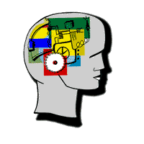
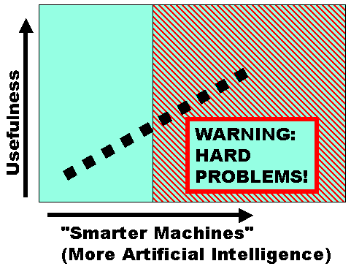
Beware of the Hype
Hype seems to suggest that Semantic Web means: “semantics + web = AI”
“A new form of Web content that is meaningful to computers will unleash a revolution of new abilities”
More realistic to think of it as meaning: “semantics + web + AI = more useful web”
Realising the complete “vision” is too hard for now (probably)
But we can make a start by adding semantic annotation to web resources
Images from Christine Thompson and David Booth

Slide 5
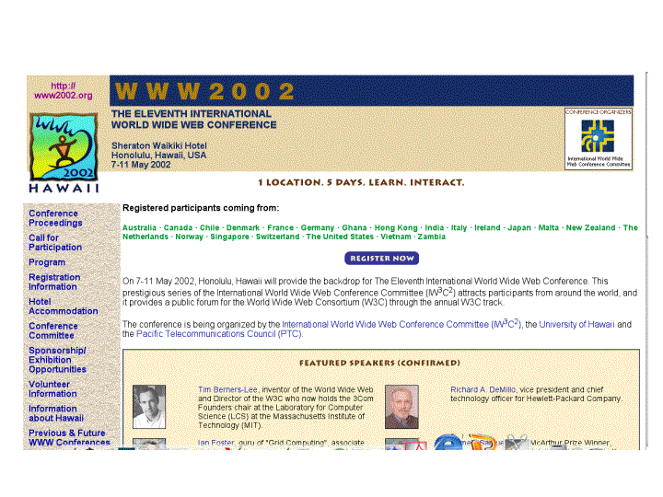
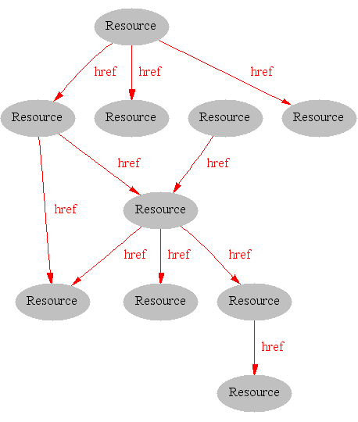
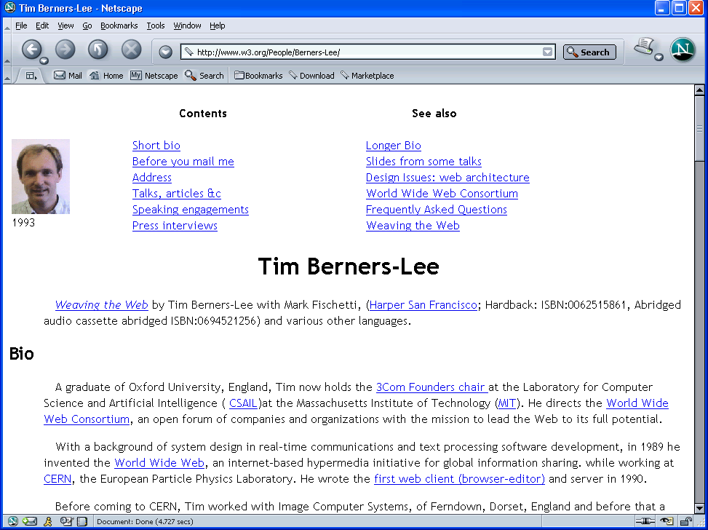
Where we are Today: the Syntactic Web
[Hendler & Miller 02]
Notes:
[1,8]

Slide 6
The Syntactic Web is…
A hypermedia, a digital library
A library of documents called (web pages) interconnected by a hypermedia of links
A database, an application platform
A common portal to applications accessible through web pages, and presenting their results as web pages
A platform for multimedia
BBC Radio 4 anywhere in the world! Terminator 3 trailers!
A naming scheme
Unique identity for those documents
A place where computers do the presentation (easy) and people do the linking and interpreting (hard).
Why not get computers to do more of the hard work?
[Goble 03]
Notes:
[1,8]

Slide 7
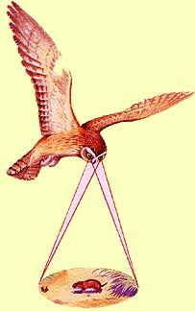
Impossible (?) using the Syntactic Web…
Complex queries involving background knowledge
Find information about “animals that use sonar but are not either bats or dolphins”
Locating information in data repositories
Travel enquiries
Prices of goods and services
Results of human genome experiments
Finding and using “web services”
Visualize surface interactions between two proteins
Delegating complex tasks to web “agents”
Book me a holiday next weekend somewhere warm, not too far away, and where they speak French or English
, e.g., Barn Owl

Slide 8
What is the Problem?
Consider a typical web page:
Markup consists of:
rendering information (e.g., font size and colour)
Hyper-links to related content
Semantic content is accessible to humans but not (easily) to computers…
Notes:
[1,8]

Slide 9
What information can we see…
WWW2002
The eleventh international world wide web conference
Sheraton waikiki hotel
Honolulu, hawaii, USA
7-11 may 2002
1 location 5 days learn interact
Registered participants coming from
australia, canada, chile denmark, france, germany, ghana, hong kong, india, ireland, italy, japan, malta, new zealand, the netherlands, norway, singapore, switzerland, the united kingdom, the united states, vietnam, zaire
Register now
On the 7th May Honolulu will provide the backdrop of the eleventh international world wide web conference. This prestigious event …
Speakers confirmed
Tim berners-lee
Tim is the well known inventor of the Web, …
Ian Foster
Ian is the pioneer of the Grid, the next generation internet …
Notes:
[1]
9-13 arasındaki çorba kodlar gösterilmeyebilir:...!? – [8]’deki gibi olabilir...

Slide 10
What information can a machine see…
WWW2002
The eleventh international world wide web conference
Sheraton waikiki hotel
Honolulu, hawaii, USA
7-11 may 2002
1 location 5 days learn interact
Registered participants coming from
australia, canada, chile denmark, france, germany, ghana, hong kong, india, ireland, italy, japan, malta, new zealand, the netherlands, norway, singapore, switzerland, the united kingdom, the united states, vietnam, zaire
Register now
On the 7th May Honolulu will provide the backdrop of the eleventh international world wide web conference. This prestigious event …
Speakers confirmed
Tim berners-lee
Tim is the well known inventor of the Web, …
Ian Foster
Ian is the pioneer of the Grid, the next generation internet …
Notes:
[1]

Slide 11
Solution: XML markup with “meaningful” tags?
<name>WWW2002
The eleventh international world wide webcon</name>
<location>Sheraton waikiki hotel
Honolulu, hawaii, USA</location>
<date>7-11 may 2002</date>
<slogan>1 location 5 days learn interact</slogan>
<participants>Registered participants coming from
australia, canada, chile denmark, france, germany, ghana, hong kong, india, ireland, italy, japan, malta, new zealand, the netherlands, norway, singapore, switzerland, the united kingdom, the united states, vietnam, zaire</participants>
<introduction>Register now
On the 7th May Honolulu will provide the backdrop of the eleventh international world wide web conference. This prestigious event …
Speakers confirmed</introduction>
<speaker>Tim berners-lee</speaker>
<bio>Tim is the well known inventor of the Web,</bio>…
Notes:
[1]

Slide 12
But What About…
<conf>WWW2002
The eleventh international world wide webcon</conf>
<place>Sheraton waikiki hotel
Honolulu, hawaii, USA</place>
<date>7-11 may 2002</date>
<slogan>1 location 5 days learn interact</slogan>
<participants>Registered participants coming from
australia, canada, chile denmark, france, germany, ghana, hong kong, india, ireland, italy, japan, malta, new zealand, the netherlands, norway, singapore, switzerland, the united kingdom, the united states, vietnam, zaire</participants>
<introduction>Register now
On the 7th May Honolulu will provide the backdrop of the eleventh international world wide web conference. This prestigious event …
Speakers confirmed</introduction>
<speaker>Tim berners-lee</speaker>
<bio>Tim is the well known inventor of the Web,…

Slide 13
Still the Machine only sees…
<name>WWW2002
The eleventh international world wide webc</name>
<location>Sheraton waikiki hotel
Honolulu, hawaii, USA</location>
<date>7-11 may 2002</date>
<slogan>1 location 5 days learn interact</slogan>
<participants>Registered participants coming from
australia, canada, chile denmark, france, germany, ghana, hong kong, india, ireland, italy, japan, malta, new zealand, the netherlands, norway, singapore, switzerland, the united kingdom, the united states, vietnam, zaire</participants>
<introduction>Register now
On the 7th May Honolulu will provide the backdrop of the eleventh international world wide web conference. This prestigious event …
Speakers confirmed</introduction>
<speaker>Tim berners-lee</speaker>
<bio>Tim is the well known inventor of the W</bio>
<speaker>Ian Foster</speaker>
<bio>Ian is the pioneer of the Grid, the ne</bio>
Notes:
[1], son 4 tane için için [2]’ye de bakılabilir...

Slide 14

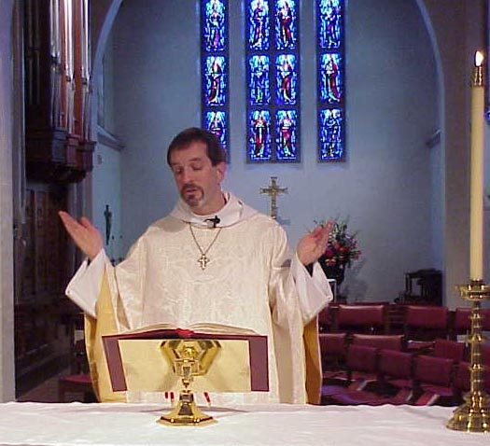
What is the (Proposed) Solution?
Add semantic annotations to web resources
Dr. <Person>Alan Rector</Person>, <Job>Professor of Computer Science</Job>, University of Manchester
Dr. Alan Rector, Professor of Computer Science, University of Manchester
Rev. <Person>Alan M. Gates</Person>, <Job>Associate Rector</Job> of the Church of the Holy Spirit, Lake Forest, Illinois
Rev. Alan M. Gates, Associate Rector of the Church of the Holy Spirit, Lake Forest, Illinois
Notes:
[8]
NL annotations (possibly with rendering annotation) already associated with images (only way google can find them)
Augment NL with semantic annotation.

Slide 15
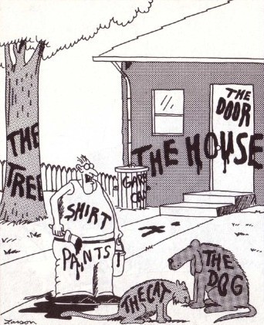
What is the (Proposed) Solution?
Now... that should clear up a few things around here
Notes:
[8]
NL annotations (possibly with rendering annotation) already associated with images (only way google can find them)
Augment NL with semantic annotation.

Slide 16
Giving Semantics to Annotations
External agreement on meaning of annotations
Agree on meaning of a set of annotation tags
E.g., Dublin Core
Limited flexibility and extensibility
Limited number of things can be expressed
Use Ontologies to specify meaning of annotations
Agree on language used to describe meaning
Meanings of vocabularies of terms given by ontologies
New terms can be formed by combining existing ones
Meaning (semantics) of such terms is formally specified
Can combine/relate terms in multiple ontologies
Notes:
[1,8]
Big Apple is a large fruit or a city? [8]

Slide 17
Dublin Core
A set of fifteen basic properties for describing generalised Web resources
ISO Standard 15836-2003 (February 2003): http://www.niso.org/international/SC4/n515.pdf
The Dublin Core Metadata Initiative is an open forum engaged in the development of interoperable online metadata standards that support a broad range of purposes and business models.
http://dublincore.org/
Notes:
[3]

Slide 18
Dublin Core (15 basic properties):
Type
Format
Identifier
Source
Language
Relation
Coverage
Rights
Title
Creator
Subject
Description
Publisher
Contributor
Date
Notes:
[3]

Slide 19
Dublin Core Example
<?xml version="1.0"?>
<rdf:RDF xmlns:rdf=“http://www.w3.org/1999/02/22-rdf-syntax-ns#”
xmlns:dc="http://purl.org/dc/elements/1.0/">
<rdf:Description rdf:about="http://www.ukoln.ac.uk/metadata/resources/dc/ datamodel/WD-dc-rdf/">
<dc:title> Guidance on expressing the Dublin Core within the Resource
Description Framework (RDF) </dc:title>
<dc:creator> Eric Miller </dc:creator>
<dc:creator> Paul Miller </dc:creator>
<dc:creator> Dan Brickley </dc:creator>
<dc:subject> Dublin Core; Resource Description Framework; RDF; eXtensible
Markup Language; XML </dc:subject>
<dc:publisher> Dublin Core Metadata Initiative </dc:publisher>
<dc:contributor> Dublin Core Data Model Working Group </dc:contributor>
<dc:date> 1999-07-01 </dc:date>
<dc:format> text/html </dc:format>
<dc:language> en </dc:language>
</rdf:Description>
</rdf:RDF>
Notes:
[3]

Slide 20
Ontological Vision of Semantic Web
Semantic Web needs ontologies
An ontology is
document or file that formally and in a standardized way defines the hierarchy of classes within the domain, semantic relations among terms and inference rules
Use of ontologies:
Sharing semantics of your data across distributed applications
Notes:
20
[3,8]

Slide 21
Why Develop an Ontology?
To share common understanding of the structure of descriptive information
among people
among software agents
between people and software
To enable reuse of domain knowledge
to avoid “re-inventing the wheel”
to introduce standards to allow interoperability
Notes:
[5]

Slide 22
An Ontology should be just the Beginning
Databases
Ontologies
Declare
structure
Knowledge
bases
The “Semantic Web”
Provide
domain
description
Software agents
Problem-solving methods
Domain-independent
applications
Notes:
[5]

Slide 23
Ontology Examples
Taxonomies on the Web
Yahoo! categories
Catalogs for on-line shopping
Amazon.com product catalog
Dublin Core and other standards for the Web
Domain independent examples
Ontoclean
Sumo
Notes:
[5]

Slide 24
Ontology in Information Science
An ontology is an engineering artefact consisting of:
A vocabulary used to describe (a particular view of) some domain
An explicit specification of the intended meaning of the vocabulary.
Often includes classification based information
Constraints capturing background knowledge about the domain
Ideally, an ontology should:
Capture a shared understanding of a domain of interest
Provide a formal and machine manipulable model
Notes:
[8]
TODO: maddelerin altlarını örneklendir [9]’un 20.sayfasındakine benzer
In Information Science, an ontology is the product of an attempt to formulate an exhaustive and rigorous conceptual schema about a domain. This domain does not have to be the complete knowledge of that topic, but purely a domain of interest decided upon by the creator of the ontology.
An ontology is typically a hierarchical data structure containing all the relevant entities and their relationships and rules within that domain (e.g., a domain ontology). However, computational ontology does not have to be hierarchical at all. The computer science usage of the term ontology is derived from the much older usage of the term ontology in philosophy.
An ontology which is not tied to a particular problem domain but attempts to describe general entities is known as a foundation ontology or upper ontology. Typically, more specialized domain specific schemata must be created to make the data useful for real world decisions.

Slide 25
Ontology Languages for the Web
Semantic Web effort led to development of “resource description” language(s)
E.g., RDF, and later RDF Schema (RDFS)
RDFS is recognisable as an ontology language
Classes and properties
Sub/super-classes (and properties)
Range and domain (of properties)
But RDFS too weak to describe resources in sufficient detail, e.g.:
No existence/cardinality constraints
No transitive, inverse or symmetrical properties
No localised range and domain constraints
…
And RDF(S) has “higher order flavour” with non-standard semantics
Difficult to provide reasoning support
Notes:
[8]

Slide 26

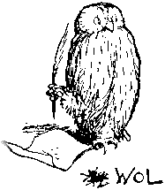
From RDFS to OWL
Two languages developed to address deficiencies & problems of RDFS:
OIL: developed by group of (largely) European researchers
DAML-ONT: developed by group of (largely) US researchers
Efforts merged to produce DAML+OIL
Development carried out by “Joint EU/US Committee on Agent Markup Languages”
DAML+OIL submitted to as basis for standardisation
Web-Ontology (WebOnt) Working Group formed
WebOnt developed OWL language based on DAML+OIL
OWL now a W3C recommendation (i.e., a standard)
OIL, DAML+OIL and OWL based on Description Logics
OWL is effectively a “Web-friendly” syntax for SHOIN
Notes:
[8]

Slide 27


Semantic Web basics...
RDF:
stands for Resource Description Framework
is a W3C standard, which provides tool to describe Web resources
provides interoperability between applications that exchange machine-understandable information
RDF Schema:
is a W3C standard which defines vocabulary for RDF
organizes this vocabulary in a typed hierarchy (Class, Property, type, subClassOf, subPropertyOf, range, domain)
capable to explicitly declare semantic relations between vocabulary terms
Notes:
[3,4]

Slide 28
RDF and RDFS
RDF stands for Resource Description Framework
It is a W3C candidate recommendation (http://www.w3.org/RDF)
RDF is graphical formalism ( + XML syntax + semantics)
for representing metadata
for describing the semantics of information in a machine- accessible way
RDFS extends RDF with “schema vocabulary”, e.g.:
Class, Property
type, subClassOf, subPropertyOf
range, domain
Notes:
[4]

Slide 29

RDF – Semantic Web over Web Resources
John
Director
has_homepage
has_job
Ontology
to_be_in_love_with
has_job
has_homepage
Secretary
Mary
Notes:
[3]

Slide 30
The RDF Data Model
Statements are <subject, predicate, object> triples:
Can be represented using XML serialisation, e.g.:
<Ian,hasColleague,Uli>
Statements describe properties of resources
All things (including properties) being described by RDF expressions are called resources
A resource is a URI representing a (class of) object(s):
a document, a picture, a paragraph on the Web;
http://www.cs.man.ac.uk/index.html
a book in the library, a real person (?)
isbn://5031-4444-3333
…
hasColleague
Ian
Uli
Notes:
[4] {
RDF Statement:
Subject of an RDF statement is a resource
Predicate of an RDF statement is a property of a resource
Object of an RDF statement is the value of a property of a resource
}

Slide 31
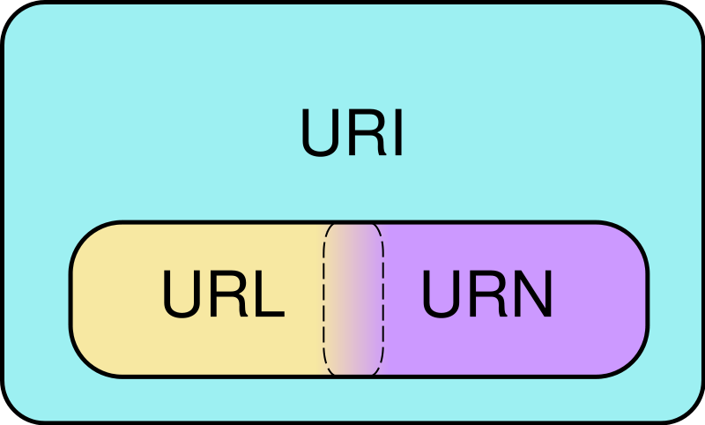
URI
Venn diagram of Uniform Resource Identifier (URI) scheme categories. Schemes in the URL (locator) and URN (name) categories both function as resource IDs, so URL and URN are subsets of URI. They are also, generally, disjoint sets. However, many schemes can't be categorized as strictly one or the other, because all URIs can be treated as names, and some schemes embody aspects of both categories – or neither.
http://www.somedomain.com/some/path/to/file#fragmentID
Notes:
[3]

Slide 32
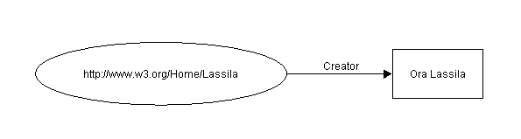
Example of RDF Statement
Ora Lassila is the creator of the resource http://www.w3.org/Home/Lassila.
Subject (resource)
http://www.w3.org/Home/Lassila
Predicate (property)
Creator
Object (literal)
“Ora Lassila”
Notes:
[3] -> kendi örneğini geliştir (Hasan hasColleague Tolga)

Slide 33
RDF Example (serialization syntax)
Ora Lassila is the creator of the resource http://www.w3.org/Home/Lassila.
<rdf:RDF>
<rdf:Description about=
"http://www.w3.org/Home/Lassila">
<s:Creator>Ora Lassila</s:Creator>
</rdf:Description>
</rdf:RDF>
's' is a specific namespace prefix, e.g.
xmlns:s="http://description.org/schema/"
Notes:
[3]

Slide 34
RDF Schema (RDFS)
RDF gives a formalism for meta data annotation, and a way to write it down in XML, but it does not give any special meaning to vocabulary such as subClassOf or type
Interpretation is an arbitrary binary relation
I.e., <Person,subClassOf,Animal> has no special meaning
RDF Schema defines “schema vocabulary” that supports definition of ontologies
gives “extra meaning” to particular RDF predicates and resources (such as subClasOf)
this “extra meaning”, or semantics, specifies how a term should be interpreted
Notes:
[4]

Slide 35
What is RDFS ?
RDF Schema
Defines vocabulary for RDF
Organizes this vocabulary in a typed hierarchy (Class, subClassOf, type, Property, subPropertyOf, range, domain)
Rich, web-based publication format for declaring semantics (XML for exchange)
Capability to explicitly declare semantic relations between vocabulary terms
Notes:
[3]
[4] {
RDF gives a formalism for meta data annotation, and a way to write it down in XML, but it does not give any special meaning to vocabulary such as subClassOf or type
Interpretation is an arbitrary binary relation
I.e., <Person,subClassOf,Animal> has no special meaning
RDF Schema defines “schema vocabulary” that supports definition of ontologies
gives “extra meaning” to particular RDF predicates and resources (such as subClasOf)
this “extra meaning”, or semantics, specifies how a term should be interpreted
}

Slide 36
RDF Schema
Semantic network on the Web
Nodes are identified by URIs
rdfs:Class
rdfs:Property
rdfs:subClassOf
Notes:
[3]

Slide 37
RDFS Examples
RDF Schema terms (just a few examples):
Class
Property
type
subClassOf
range
domain
These terms are the RDF Schema building blocks (constructors) used to create vocabularies:
<Person,type,Class>
<hasColleague,type,Property>
<Professor,subClassOf,Person>
<Carole,type,Professor>
<hasColleague,range,Person>
<hasColleague,domain,Person>
Notes:
[4] + class diagram ve owl kodu ekle

Slide 38
Problems with RDFS
RDFS too weak to describe resources in sufficient detail
No localised range and domain constraints
Can’t say that the range of hasChild is person when applied to persons and elephant when applied to elephants
No existence/cardinality constraints
Can’t say that all instances of person have a mother that is also a person, or that persons have exactly 2 parents
No transitive, inverse or symmetrical properties
Can’t say that isPartOf is a transitive property, that hasPart is the inverse of isPartOf or that touches is symmetrical
…
Difficult to provide reasoning support
No “native” reasoners for non-standard semantics
May be possible to reason via FO axiomatisation
Notes:
[4]

Slide 39
OWL became standard
10 February 2004 the World Wide Web Consortium announced final approval of two key Semantic Web technologies, the revised Resource Description Framework (RDF) and the Web Ontology Language (OWL).
Read more in:
http://www.w3.org/2004/01/sws-pressrelease.html.en
Notes:
39
[3]
OWL language now a w3c recommendadion (i.e., a standard like HTML and XML)

Slide 40
OWL Introduction
What is OWL?
OWL is a language for defining Web Ontologies and their associated Knowledge Bases
The OWL language is a revision of the DAML+OIL web ontology language incorporating learning from the design and application use of DAML+OIL.
OWL extends RDFS vocabulary and adds axioms.
Notes:
40
[3]

Slide 41
OWL Language
Three species of OWL
OWL full is union of OWL syntax and RDF
OWL DL restricted to FOL fragment (¼ DAML+OIL)
OWL Lite is “easier to implement” subset of OWL DL
Semantic layering
OWL DL ¼ OWL full within DL fragment
DL semantics officially definitive
OWL DL based on SHIQ Description Logic
In fact it is equivalent to SHOIN(D_{n}) DL
OWL DL Benefits from many years of DL research
Well defined semantics
Formal properties well understood (complexity, decidability)
Known reasoning algorithms
Implemented systems (highly optimised)
Notes:
[4]

Slide 42
What Are Description Logics?
A family of logic based Knowledge Representation formalisms
Descendants of semantic networks and KL-ONE
Describe domain in terms of concepts (classes), roles (properties, relationships) and individuals
Operators allow for composition of complex concepts
Names can be given to complex concepts, e.g.:
HappyParent ´ Parent u 8hasChild.(Intelligent t Athletic)
HappyParent ´ Parent u 8hasChild.(Intelligent t Athletic)
HappyParent ´ Parent u 8hasChild.(Intelligent t Athletic)
HappyParent ´ Parent u 8hasChild.(Intelligent t Athletic)
HappyParent ´ Parent u 8hasChild.(Intelligent t Athletic)
Notes:
[8]
Object oriented style of modelling

Slide 43
Description Logics
Underneath:
computationally tractable subsets of first order logic
Describes relations between Concepts/Classes
Individuals secondary
DL Ontologies are NOT databases!
Notes:
[5]

Slide 44
Description Logic Family
DLs are a family of logic based KR formalisms
Particular languages mainly characterized by:
Set of constructors for building complex concepts and roles from simpler ones
Set of axioms for asserting facts about concepts, roles and individuals
Examples:
“Female persons”
Person ⊓ Female
“Non-female persons”
Person ⊓ ¬Female
“Persons that have a child”
Person ⊓ ∃hasChild.Person
“Persons all of whose children are female”
Person ⊓ ∀hasChild.Female
“Persons that are employed or self-eployed”
Person ⊓ (Employee ⊔ SelfEmployed)
“Persons that have at most one father“
Person ⊓ ≤1.hasFather
Notes:
44
[6]

Slide 45
And beware Ontologies are not databases!
Ontologies are (mostly) about the classes –
Can be used to represent database aspects of schemas
What must be true of any database consistent with the schema
The Terminology
What must be true of any concept consistent with the ontology
The “T-Box” – for “terminology box”
Limited functionality for individuals (‘instances’)
Primarily to help define classes
The class of John’s shirts, The class of cities in Japan
To describe individuals use
A database
Triple representation (RDF or Topic Maps)
An instance store
Perhaps with an ontology as the schema
Open world instead of closed world
Individuals in ontologies (The “A-Box”) poorly understood and very high computational complexity
Notes:
[5]

Slide 46
OWL RDF/XML Exchange Syntax
E.g., Parent u 8hasChild.(Intelligent t Athletic):
<owl:Class>
<owl:intersectionOf rdf:parseType=" collection">
<owl:Class rdf:about="#Parent"/>
<owl:Restriction>
<owl:onProperty rdf:resource="#hasChild"/>
<owl:allValuesFrom>
<owl:unionOf rdf:parseType=" collection">
<owl:Class rdf:about="#Intelligent"/>
<owl:Class rdf:about="#Athletic"/>
</owl:unionOf>
</owl:allValuesFrom>
</owl:Restriction>
</owl:intersectionOf>
</owl:Class>

Slide 47
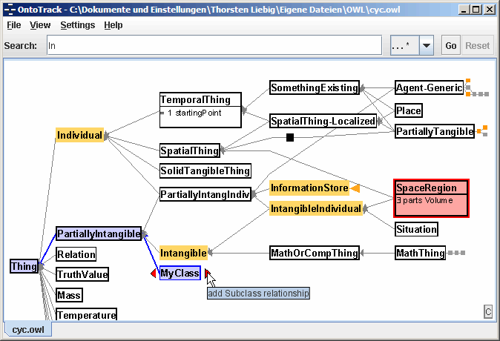
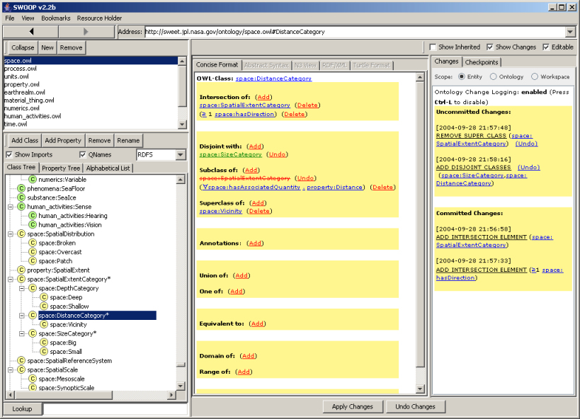
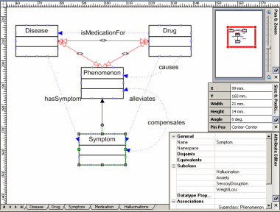
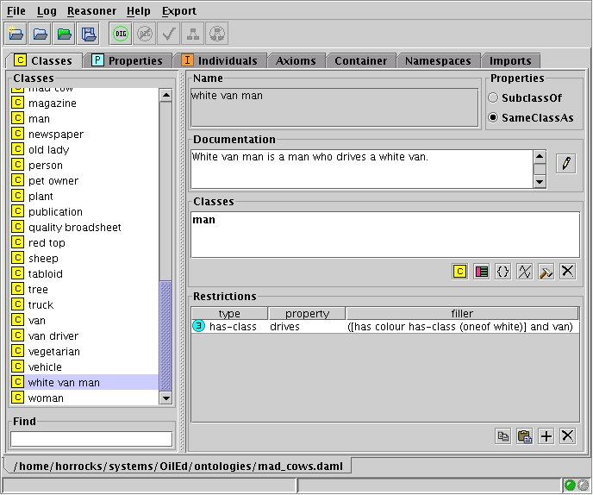
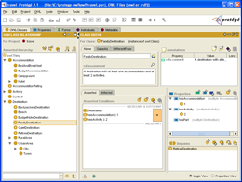
Tools and Infrastructure
Editors/environments
Oiled, Protégé, Swoop, Construct, Ontotrack, …
Notes:
[8]

Slide 48




Tools and Infrastructure
Editors/environments
Oiled, Protégé, Swoop, Construct, Ontotrack, …
Reasoning systems
Cerebra, FaCT++, Kaon2, Pellet, Racer, …
Pellet
Notes:
[8]

Slide 49
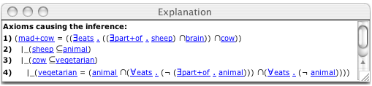
Tools and Infrastructure
Editors/environments
Oiled, Protégé, Swoop, Construct, Ontotrack, …
Reasoning systems
Cerebra, FaCT++, Kaon2, Pellet, Racer, …
Non-standard inferences
Explanation, matching, least common subsumer, …
Notes:
[8]

Slide 50
Tools and Infrastructure
Editors/environments
Oiled, Protégé, Swoop, Construct, Ontotrack, …
Reasoning systems
Cerebra, FaCT++, Kaon2, Pellet, Racer, …
Non-standard inferences
Explanation, matching, least common subsumer, …
Design methodologies
Foundational ontologies, modularisation, etc.
Entity
Endurant
Perdurant
Quality
Substantial
Event
Stative
Achievement
Accomplishment
Notes:
[8]

Slide 51
Summary
Semantic Web aims to make web content more accessible to automated processes
Adds semantic annotations to web resources
Ontologies provide vocabulary for annotations
Terms have well defined meaning
OWL ontology language based on (description) logic
Exploits results of basic research on complexity, reasoning, etc.
Many research challenges remain
Including expressive power, scalability and tools
Notes:
[8]

Slide 52
Where to look next
RDF: http://www.w3.org/RDF/
RDF Schema: http://www.w3.org/TR/rdf-schema/
Notes:
[3]

Slide 53
OWL
DL
Ontology vs Database

